Slide 1
SFIA Project
Bailey Elson

Slide 2
Project Specification
Trello Board
Relational Database
Relationship Diagrams
Risk Assessment
Functional CRUD Application
Testing
Functioning User Interface
Functioning CI Pipeline

Slide 3
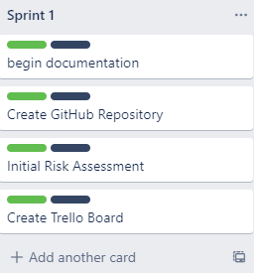
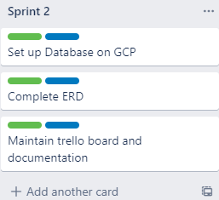
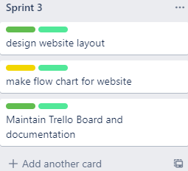
Trello Board - Sprints

Slide 4
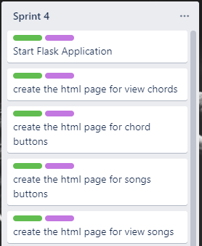
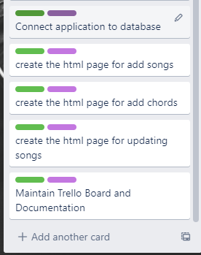
Trello Board - Sprints

Slide 5
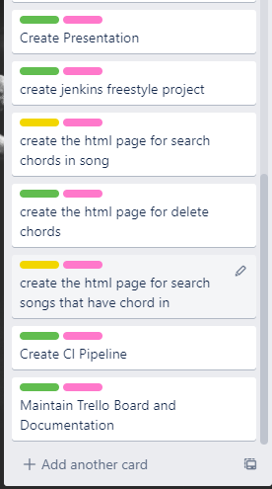
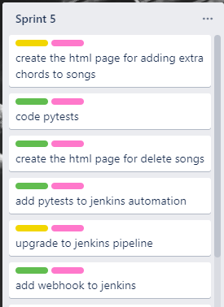
Trello Board - Sprints

Slide 6
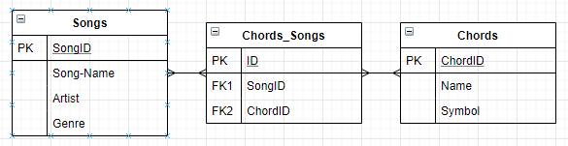
Original Design

Slide 7
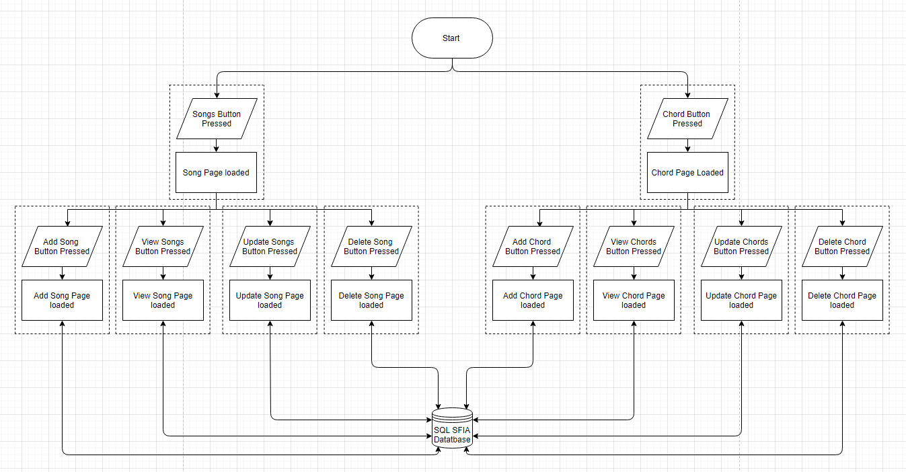
Original Design

Slide 8
My Solution
http://34.68.124.32:5000/

Slide 9
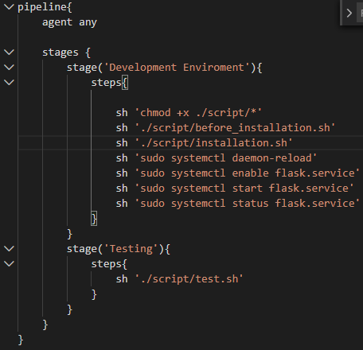
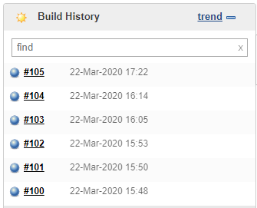
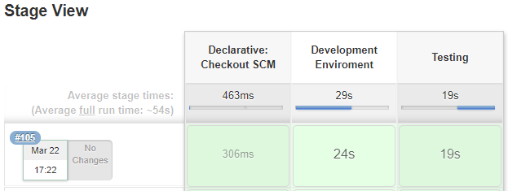
Jenkins

Slide 10

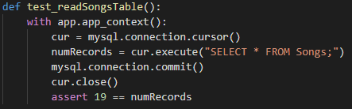
Testing
URL Testing:
Database Testing:

Slide 11

Testing Results
Pytest:
Coverage:

Slide 12

Evaluation
Trello Board
Relational Database
Relationship Diagrams
Risk Assessment
Functional CRUD Application
Testing
Functioning User Interface
Functioning CI Pipeline

Slide 13
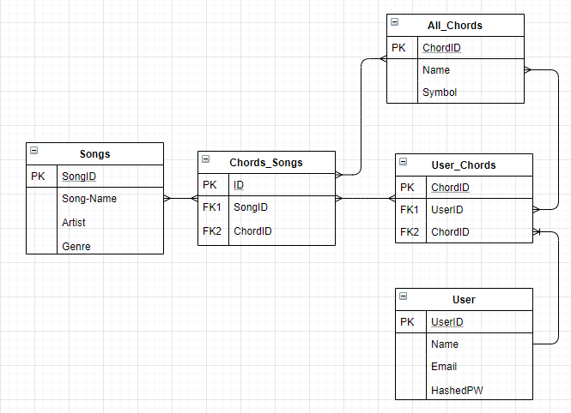
Possible Added Features
Selenium Testing
User Log in function

